Slide 1


Mansoura University Faculty of Computers and Information Second Semester- 2020-2021
Computer Graphics
Grade: 2nd Year (General –BIO)
Prepared by: Dr.- Haitham El-Ghareeb,
Dr.-Waleed Mohamed,
Dr.-Ibrahim El-Hasnony

Slide 2
2D transformation

Slide 3
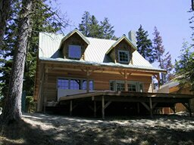
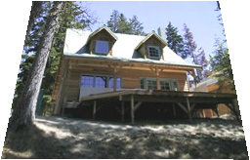
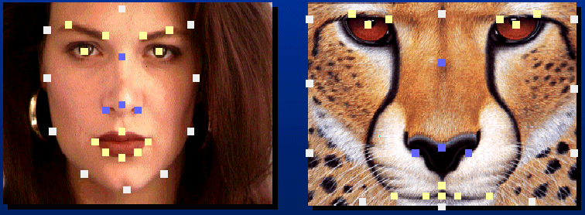
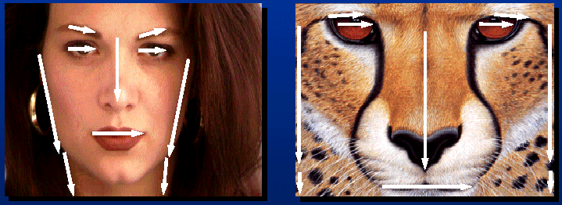
Applications of 2D Transformations
2D geometric transformations.
Animation.
Image warping
Image morphing

Slide 4
2D transformation
A transformation is a function that takes a point (or vector) and maps it into another point (or vector).
Changing Position, shape, size, or orientation of an object on display.
Transformation is needed to observe objects in some other coordination systems and animations.
A Cartographer can change the size of charts and topographical maps. So, if graphics images are coded as numbers, the numbers can be stored in memory. These numbers are modified by mathematical operations called Transformation.
The purpose of using computers for drawing is to provide a facility to the user to view the object from different angles, enlarging or reducing the scale or shape of the object.

Slide 5
2D transformation
Basic transformation includes three transformations Translation, Rotation, and Scaling.
These three transformations are known as basic transformations because with the combination of these three transformations we can obtain any transformation.

Slide 6
2D Transformation
Given a 2D object, transformation is to change the object’s
Position (translation)
Size (scaling)
Orientation (rotation)
Shapes (shear)
Apply a sequence of matrix multiplications to the object vertices

Slide 7
Example: 2D Geometric Transformation
Modeling
Coordinates
World Coordinates

Slide 8
Example: 2D Scaling
Modeling
Coordinates
Scale(0.3, 0.3)
World Coordinates

Slide 9
Example: 2D Rotation
Modeling
Coordinates
Scale(0.3, 0.3)
Rotate(-90)
World Coordinates

Slide 10
Example: 2D Translation
Modeling
Coordinates
Scale(0.3, 0.3)
Rotate(-90)
Translate(5, 3)
World Coordinates

Slide 11
Basic 2D Transformations
Translation
Scale
Rotation
Shear

Slide 12
Basic 2D Transformations
Translation
Scale
Rotation
Shear
Transformations
can be combined
(with simple algebra)

Slide 13
Basic 2D Transformations
Translation
Scale
Rotation
Shear

Slide 14
Basic 2D Transformations
Translation
Scale
Rotation
Shear

Slide 15
Basic 2D Transformations
Translation
Scale
Rotation
Shear

Slide 16
Basic 2D Transformations
Translation
Scale
Rotation
Shear

Slide 17
Matrix Representation
Represent a 2D Transformation by a Matrix
Apply the Transformation to a Point
Transformation
Matrix
Point

Slide 18
Matrix Representation
Transformations can be combined by matrix multiplication
Transformation
Matrix
Matrices are a convenient and efficient way
to represent a sequence of transformations

Slide 19
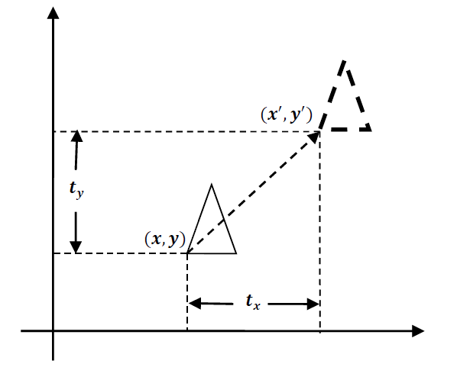
1- translation
It is the straight line movement of an object from one position to another. The object is positioned from one coordinate location to another.
To translate a point from coordinate position (x, y) to another (x`, y`), we add algebraically the translation distances T_{x} and T_{y} to the original coordinate.

Slide 20
1- translation
We translate two dimensional point by adding translation distance 𝒕_{𝒙} and 𝒕_{𝒚} to the original coordinate position (𝒙, 𝒚) to move at new position (𝒙′, 𝒚′) as:
𝒙′ = 𝒙 + 𝒕_{𝒙} & 𝒚′ = 𝒚 + 𝒕_{𝒚}
Translation distance pair (𝒕_{𝒙}, 𝒕_{𝒚}) is called a Translation Vector or Shift Vector.

Slide 21

1- translation
We can represent it into single matrix equation in column vector as;
𝑷′ = 𝑷 + 𝑻

Slide 22

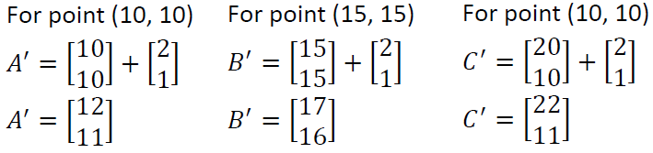
1- translation
Example:
Translate the triangle [A (10, 10), B (15, 15), C (20, 10)] 2 units in x direction and 1 unit in y direction.
Solution-We know that
𝑃′ = 𝑃 + 𝑇
Final coordinates after translation are [A’ (12, 11), B’ (17, 16), C’ (22, 11)].

Slide 23
2- rotation
It is a process of changing the angle of the object used to reposition the object along the circular path in the XY - plane.
To generate a rotation, we specify a rotation angle 𝜽 and the position of the Rotation Point (Pivot Point) (𝒙_{𝒓}, 𝒚_{𝒓}) about which the object is to be rotated.
Types of Rotation:
Clockwise
Counterclockwise
The positive value of the pivot point (rotation angle) rotates an object in a counter-clockwise (anti-clockwise) direction.
The negative value of the pivot point (rotation angle) rotates an object in a clockwise direction.

Slide 24
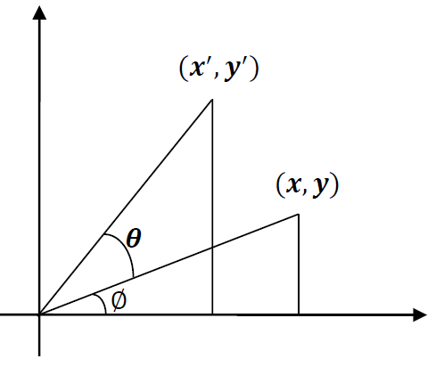
2- rotation
We first find the equation of rotation when pivot point is at coordinate origin (𝟎, 𝟎).

Slide 25

2- rotation
From the figure we can write.
𝒙 = 𝒓 𝐜𝐨𝐬 ∅
𝒚 = 𝒓 𝐬𝐢𝐧 ∅
and
𝒙′ = 𝒓 𝐜𝐨𝐬(𝜽 + ∅) = 𝒓 𝐜𝐨𝐬 ∅ 𝐜𝐨𝐬 𝜽 − 𝒓 𝐬𝐢𝐧 ∅ 𝐬𝐢𝐧 𝜽
𝒚′ = 𝒓 𝐬𝐢𝐧(∅ + 𝜽) = 𝒓 𝐜𝐨𝐬 ∅ 𝐬𝐢𝐧 𝜽 + 𝒓 𝐬𝐢𝐧 ∅ 𝐜𝐨𝐬 𝜽
Now replace 𝒓 𝐜𝐨𝐬 ∅ with 𝒙 and 𝒓 𝐬𝐢𝐧 ∅ with 𝒚 in above equation.
𝒙′ = 𝒙 𝐜𝐨𝐬 𝜽 − 𝒚 𝐬𝐢𝐧 𝜽
𝒚′ = 𝒙 𝐬𝐢𝐧 𝜽 + 𝒚 𝐜𝐨𝐬 𝜽
We can write it in the form of column vector matrix equation as;
𝑷′ = 𝑹 ∙ 𝑷

Slide 26
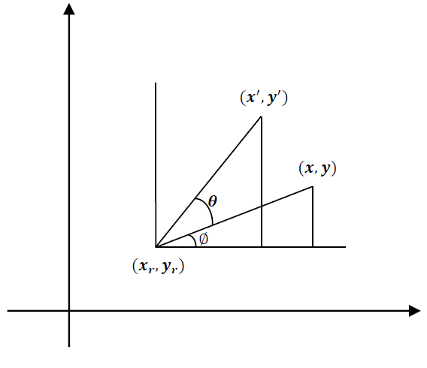
2- rotation
Rotation about arbitrary points is illustrated in the figure below.

Slide 27
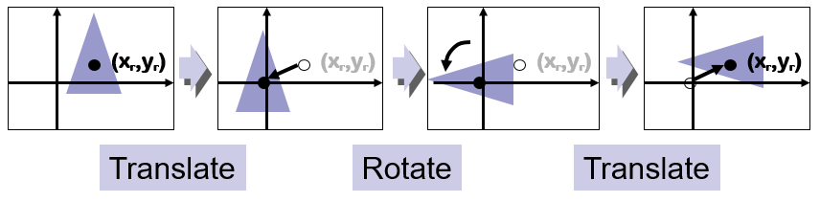
2- rotation
Transformation equation for rotation of a point about pivot point (𝒙_{𝒓}, 𝒚_{𝒓}) is:
𝒙′ = 𝒙_{𝒓} + (𝒙 − 𝒙_{𝒓}) 𝐜𝐨𝐬 𝜽 − (𝒚 − 𝒚_{𝒓}) 𝐬𝐢𝐧 𝜽
𝒚′ = 𝒚_{𝒓} + (𝒙 − 𝒙_{𝒓}) 𝐬𝐢𝐧 𝜽 + (𝒚 − 𝒚_{𝒓}) 𝐜𝐨𝐬 𝜽
These equations are different from rotation about origin and its matrix representation is also different.
Rotation is also rigid body transformation so we need to rotate each point of the object.
If we want to rotate an object or point about an arbitrary point, first of all, we translate the point about which we want to rotate to the origin. Then rotate the point or object about the origin, and at the end, we again translate it to the original place. We get rotation about an arbitrary point.

Slide 28
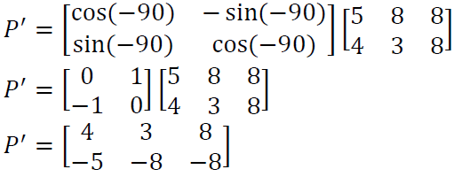
2- rotation
Example:
Locate the new position of the triangle [A (5, 4), B (8, 3), C (8, 8)] after its rotation by 90º clockwise about the origin.
Solution-As rotation is clockwise we will take 𝜃 = −90°.
𝑃′ = 𝑅 ∙ 𝑃
Final coordinates after rotation are [A’ (4, -5), B’ (3, -8), C’ (8, -8)].

Slide 29
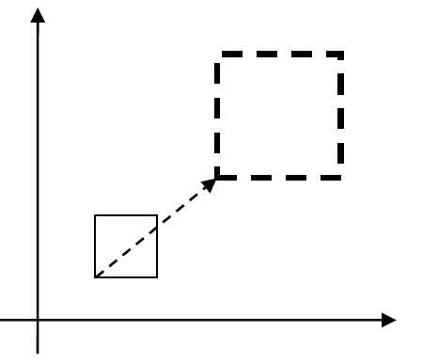

3- scaling
It is a transformation that is used to alter the size of an object.
This operation is carried out by multiplying coordinate value (𝒙, 𝒚) with scaling factor (𝒔_{𝒙}, 𝒔_{𝒚}) respectively.
Equation for scaling is given by:
𝒙′ = 𝒙 ∙ 𝒔_{𝒙}
𝒚′ = 𝒚 ∙ 𝒔_{𝒚}
These equations can be represented in column vector matrix equation as:
𝑷′ = 𝑺 ∙ 𝑷

Slide 30
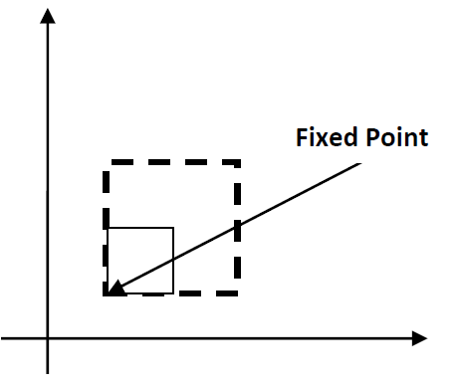
3- scaling
Any positive value can be assigned to (𝒔_{𝒙}, 𝒔_{𝒚}).
Values less than 1 reduce the size while values greater than 1 enlarge the size of the object, and the object remains unchanged when values of both factors are 1.
Same values of 𝒔_{𝒙} and 𝒔_{𝒚} will produce Uniform Scaling. And different values of 𝒔_{𝒙} and 𝒔_{𝒚} will produce Differential Scaling.
If the picture is enlarged to twice its original size, then S_{x} = S_{y} =2. If S_{x} and S_{y} are not equal, then scaling will occur but it will elongate or distort the picture.
Scaling factor with value less than 1 will move object closer to origin, while scaling factor with value greater than 1 will move object away from origin.
We can control the position of object after scaling by keeping one position fixed called Fix point (𝒙_{𝒇}, 𝒚_{𝒇}) that point will remain unchanged after the scaling transformation.

Slide 31
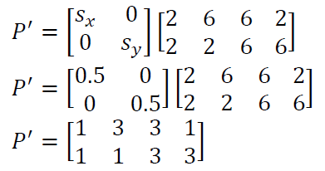
3- scaling
Example:
Consider square with left-bottom corner at (2, 2) and right-top corner at (6, 6) apply the transformation which makes its size half.
Solution- As we want size half so value of scale factor is 𝑠_{𝑥} = 0.5, 𝑠_{𝑦} =0.5 and Coordinates of square are [A (2,2), B (6, 2), C (6, 6), D (2, 6)].
𝑃′ = 𝑆 ∙ 𝑃
Final coordinates after scaling are [A’ (1, 1), B’ (3, 1), C’ (3, 3), D’ (1, 3)].

Slide 32
Matrix Representation and homogeneous coordinates
Many graphics applications involve sequences of geometric transformations.
We have seen that each of the three basic two-dimensional transformations (translation, rotation, and scaling) can be expressed in the general matrix form
P′ = M₁ · P +M₂
To produce a sequence of transformations with these equations, such as scaling followed by rotation and then translation, we could calculate the transformed coordinates one step at a time. First, coordinate positions are scaled, then these scaled coordinates are rotated, and finally, the rotated coordinates are translated.
A more efficient approach, however, is to combine the transformations so that the final coordinate positions are obtained directly from the initial coordinates, without calculating intermediate coordinate values. We can do this by reformulating Equation to eliminate the matrix addition operation.
For two dimensional geometric transformations we can take value of 𝒉 is any positive number so we can get infinite homogeneous representation for coordinate value (𝒙, 𝒚).
But convenient choice is set 𝒉 = 𝟏 as it is multiplicative identity, then (𝒙, 𝒚) is represented as (𝒙, 𝒚, 𝟏).

Slide 33
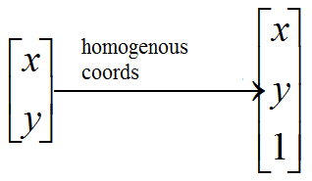
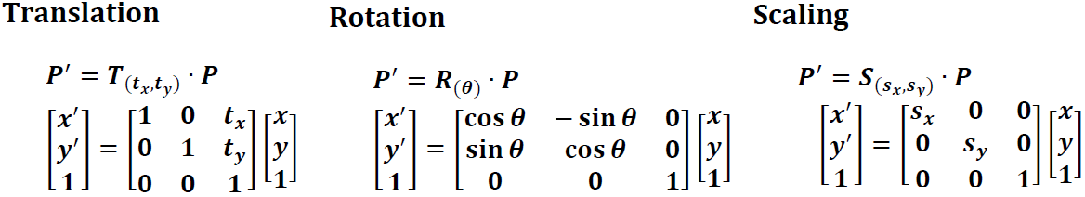
Matrix Representation and homogeneous coordinates

Slide 34
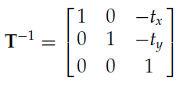

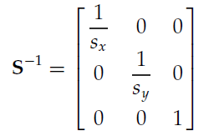
Inverse Transformations

Slide 35
4- reflection
A reflection is a transformation that produces a mirror image of an object.
The mirror image for a two –dimensional reflection is generated relative to an axis of reflection by rotating the object 180º about the reflection axis.
Reflection gives an image based on the position of the axis of reflection.

Slide 36
4- reflection
Reflection with respect to the axis
y
1
y
y
1
1’
1’
2
3
2
3
3’
2
3’
2
x
x
3
x
2’
3’
1
1’
2

Slide 37
4- reflection
Reflection with respect to a Line
Clockwise rotation of 45 → Reflection about the x axis → Counterclockwise rotation of 45
y
x
y
y
1
y
2
3
x
2’
3’
x
x
1’

Slide 38
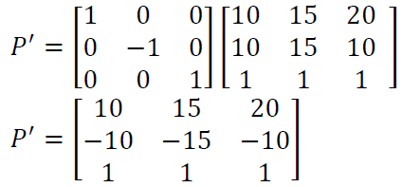
4- reflection
Example:
Find the coordinates after reflection of the triangle [A (10, 10), B (15, 15), C (20, 10)] about x axis.
Final coordinate after reflection are [A’ (10, -10), B’ (15, -15), C’ (20, -10)]

Slide 39
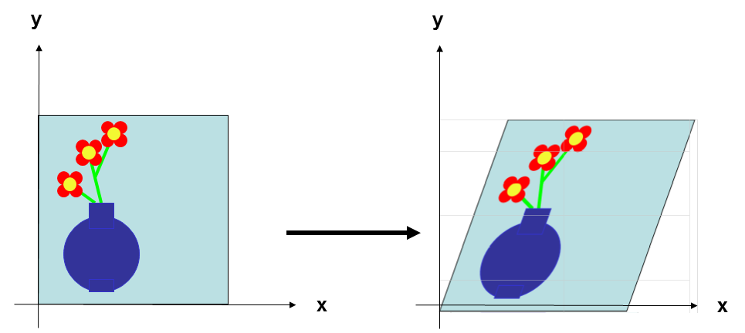
5- Shearing
It is transformation which changes the shape of an object. The sliding of layers of objects occurs. The shear can be in one direction or in two directions.
The shape of the object is distorted by producing the sliding effect of layers over each other.
EX. Shear relative to x

Slide 40
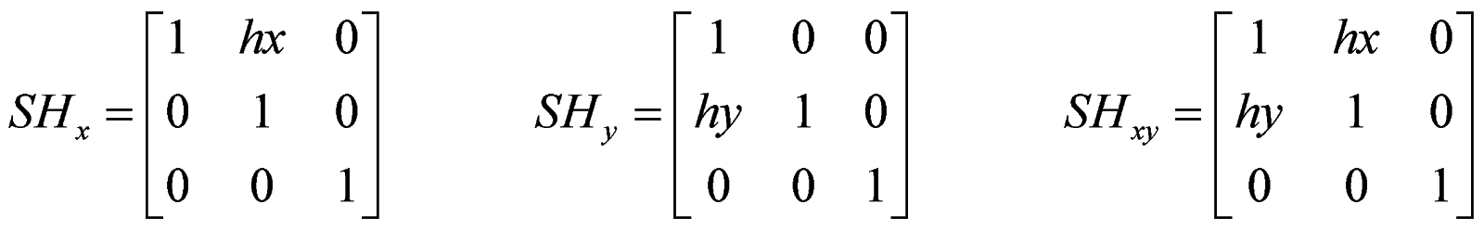
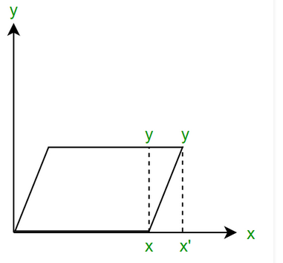
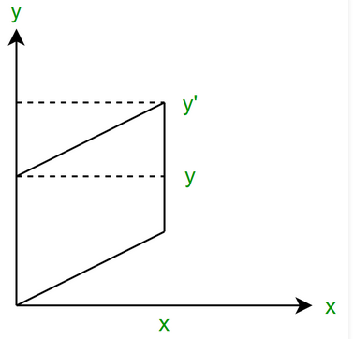
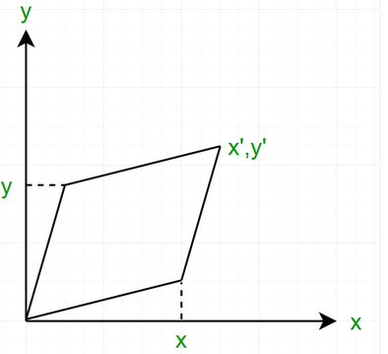
5- Shearing
The transformation matrix
Where h_{x} is a shear parameter which can take any real number value.

Slide 41
5- Shearing
Given a triangle with points (1, 1), (0, 0) and (1, 0). Find out the new coordinates of the object along x-axis, y-axis, xy-axis. (Applying shear parameter 4 on X-axis and 1 on Y-axis.).

Slide 42
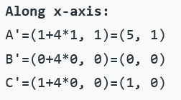
5- Shearing
Given a triangle with points (1, 1), (0, 0) and (1, 0). Find out the new coordinates of the object along x-axis, y-axis, xy-axis. (Applying shear parameter 4 on X-axis and 1 on Y-axis.).

Slide 43
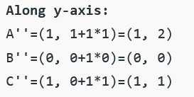
5- Shearing
Given a triangle with points (1, 1), (0, 0) and (1, 0). Find out the new coordinates of the object along x-axis, y-axis, xy-axis. (Applying shear parameter 4 on X-axis and 1 on Y-axis.).

Slide 44
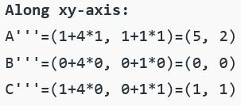
5- Shearing
Given a triangle with points (1, 1), (0, 0) and (1, 0). Find out the new coordinates of the object along x-axis, y-axis, xy-axis. (Applying shear parameter 4 on X-axis and 1 on Y-axis.).

Slide 45
2×2 Matrices
What types of transformations can be represented with a 2×2 matrix?
2D Identity
2D Scaling

Slide 46
2×2 Matrices
What types of transformations can be represented with a 2×2 matrix?
2D Rotation
2D Shearing

Slide 47
2×2 Matrices
What types of transformations can be represented with a 2×2 matrix?
2D Mirror over Y axis
2D Mirror over (0,0)

Slide 48
2×2 Matrices
What types of transformations can be represented with a 2×2 matrix?
2D Translation
NO!!
Only linear 2D transformations
can be Represented with 2x2 matrix

Slide 49
2D Translation
2D translation can be represented by a 3×3 matrix
Point represented with homogeneous coordinates

Slide 50
Basic 2D Transformations
Basic 2D transformations as 3x3 Matrices
Translate
Scale
Rotate
Shear

Slide 51
Matrix Composition
Transformations can be combined by matrix multiplication
Efficiency with premultiplication
Matrix multiplication is associative

Slide 52
Pivot-Point Rotation
(x_{r},y_{r})
(x_{r},y_{r})
(x_{r},y_{r})
(x_{r},y_{r})
Translate
Rotate
Translate

Slide 53
General Fixed-Point Scaling
(x_{f},y_{f})
(x_{f},y_{f})
(x_{f},y_{f})
(x_{f},y_{f})
Translate
Scale
Translate

Slide 54
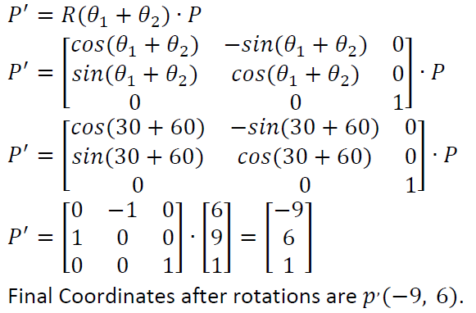
Question 1
Example: Obtain the final coordinates after two rotations on point 𝑝 (6,9) with rotation angles are 30^{𝑜} and 60^{𝑜} respectively.

Slide 55
Question 2
A triangle is defined by (2,2) , (4,2) , (4,4)
Find the transformed coordinates after the following transformations
1- 90 degree counter clockwise about the origin
2- reflection about the line y=-x

Slide 56
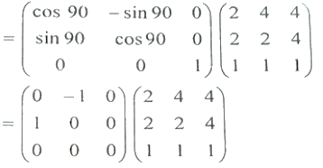
Question 2
A triangle is defined by (2,2) , (4,2) , (4,4)
Find the transformed coordinates after the following transformations
1- 90 degree counter clockwise about the origin
2- reflection about the line y=-x
1-

Slide 57
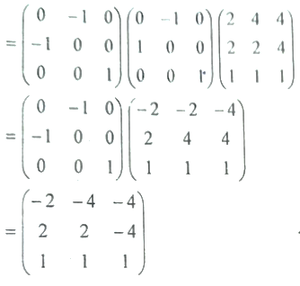
Question 2
A triangle is defined by (2,2) , (4,2) , (4,4)
Find the transformed coordinates after the following transformations
1- 90 degree counter clockwise about the origin
2- reflection about the line y=-x
2-

Slide 58
remember
Remember:
• Matrix multiplication is associative, not commutative!
• Transform matrices must be pre-multiplied
• The first transformation you want to perform will be at the far
right, just before the point

Slide 59
Thanks

